Slide 1
Control and Loop Statements
Programming for Data Analysis (CT127-3-2-PFDA and Version VC1)

Slide 2
Topic & Structure of the lesson
Control Statements
if
if … else
if … else…if
ifelse
switch
Loop Statements
for
while
repeat

Slide 3
Learning outcomes
At the end of this topic, you should be able to:
Understand various control statements in the R programming language.
Understand various loop statements in the R programming language.

Slide 4
Key terms you must be able to use
If you have mastered this topic, you should be able to use the following terms correctly in your assignments and exams:
Control Statements:
if
if … else
if … else…if
ifelse
switch
Loop Statements
for
while
repeat

Slide 5
1
Control Statements
if
if … else
if … else…if
ifelse
switch

Slide 6
Control Statements
Control Statements allow us to control the flow of the programs and cause different things to happen depending on the values of tests.
Test results in a logical, TRUE or FALSE.

Slide 7
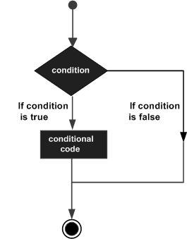
Control statement
if statement
It is one of the control statements in the R language that consists of a Boolean expression and a set of statements.
If the Boolean expression evaluates to TRUE, the set of statements is executed.
If the Boolean expression evaluates to FALSE, the statements after the end of the If statement are executed.
https://www.tutorialspoint.com/cprogramming/c_decision_making.htm

Slide 8
Control statement
if statement
The basic syntax for the if statement:
if(Boolean_expression) {
#This block of code will execute if the #Boolean expression returns TRUE.
}
Example:
x <- “Intelligent”
if (is.character(x)) {
print("X is a Character")
}

Slide 9
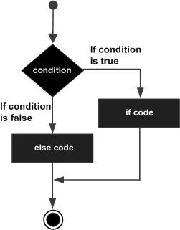
Control statement
if…else
In the if …else statement, an if statement is followed by an else statement, which contains a block of code to be executed when the Boolean expression in the if statement evaluates to FALSE.
The basic syntax of it is given below:
if(Boolean_expression)
{
#This block of code executes
#if Boolean_expression is TRUE
} else
{
#This block of code executes
#if Boolean_expression is FALSE
}
https://www.tutorialspoint.com/cprogramming/if_else_statement_in_c.htm

Slide 10
Control statement
if…else
Example:
x <- c(“java", "R", “python")
if(“R" %in% x) {
print(“found")
} else {
print("Not found")
}

Slide 11
Control statement
if…else…if
Multiple else-If statements can be included after an if statement.
Once an if statement or an else if statement evaluates to TRUE, none of the remaining else if or else statement will be evaluated.
The basic syntax of it is given below:
if(Boolean_expression1) {
#This block of code executes if the Boolean expression 1 returns TRUE
} else if(Boolean_expression2) {
#This block of code executes if the Boolean expression 2 returns TRUE
} else if(Boolean_expression3) {
#This block of code executes if the Boolean expression 3 returns TRUE
} else {
#This block of code executes if none of the Boolean expressions return TRUE
}

Slide 12
Control statement
if…else…if
Example: Write a program to check whether a number is positive, negative, or zero.
x=0
if(x>0){
print("x is positive")
} else if(x<0) {
print("x is negative")
}else {
print("x is zero")
}

Slide 13
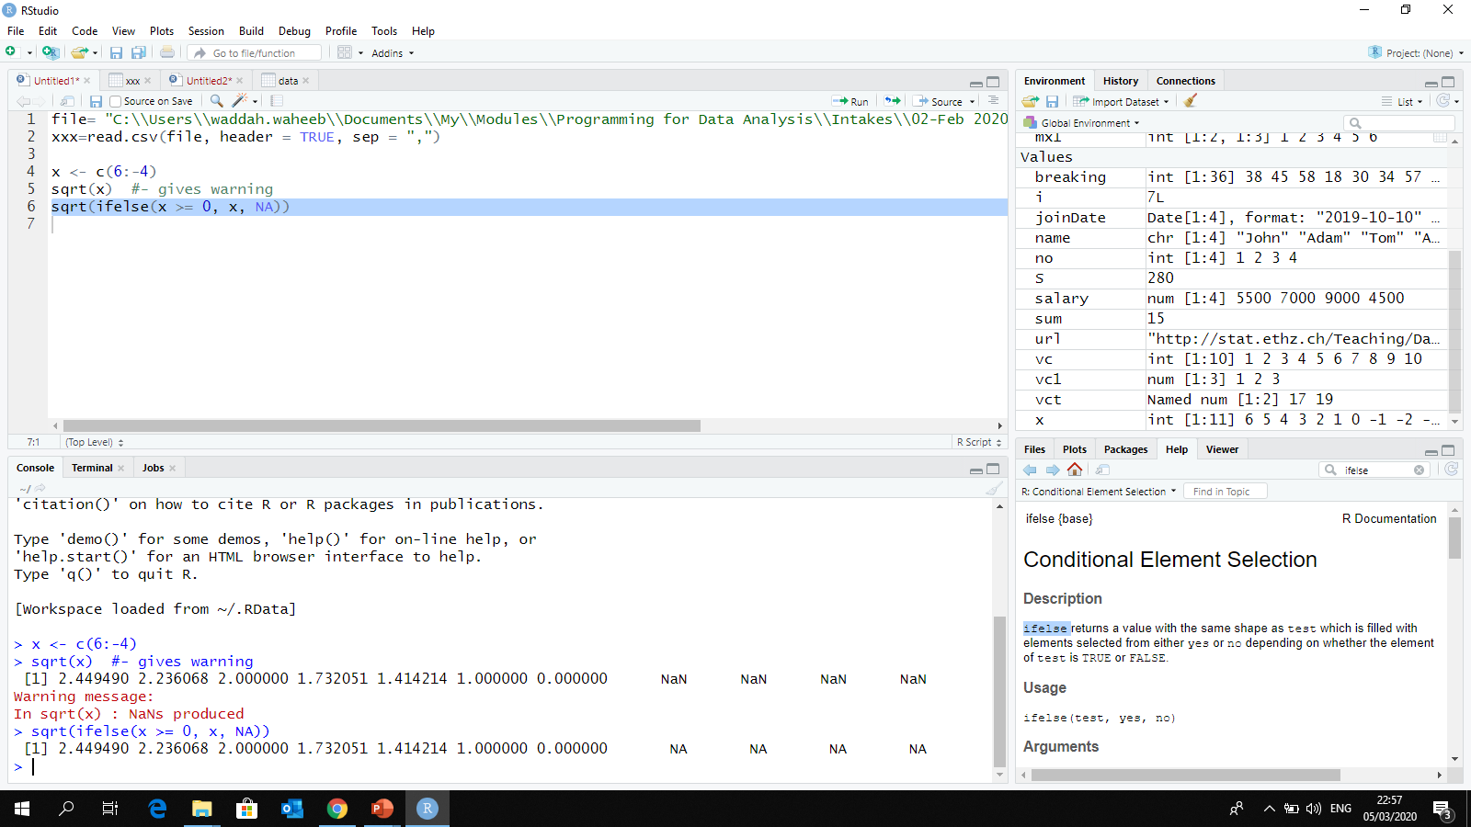
Control statement
ifelse(condition, yes, no)
It is a vector equivalent form of the if…else statement.
Example:

Slide 14
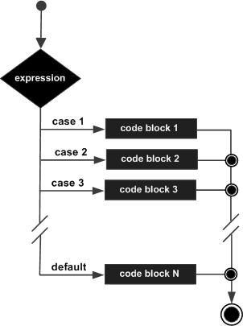
Control statement
Switch
Switch statement is one of the control statements in R which is used to equate a variable against a set of values.
Each value is called a case.
switch evaluates expression and accordingly chooses one of the further arguments (in ...).

Slide 15
Control statement
Switch
Basic syntax for a switch statement is as follows:
switch(expression, case1, case2, case3....)
Example:
grade = "B"
x=switch(grade, A="Excellent", B="Well done", C="Pass")
print(x)
[1] "Well done“
y <- switch( 3, “java", "R", “c", “python")
print(y)
[1] c

Slide 16
2
Loop Statements
for
while
repeat

Slide 17
Loop statements
The function of a looping statement is to execute a block of code several times.
It provides various control structures that allow for more complicated execution paths than a usual sequential execution.
The types of loops in R are for, while and repeat.

Slide 18
Loop statements
for
For loop executes a set of statements in a loop for a specific number of times, as per the vector provided to it.
Basic syntax of a for loop is given below
for (var in seq) {
# statements
}
Example:
v <- c(3,5,7,9,0)
for (i in 1:length(v)) {
print(v[i]) }
for (i in v) {
print(i) }

Slide 19
Loop statements
while
A while loop executes a set of statements in a loop until the condition (the Boolean expression) evaluates to FALSE.
Basic syntax of a while loop is given below
while (Boolean_expression) {
#statement
}
Example:
v <-10
while(v>0){
print(v)
v = v-1
}

Slide 20
Loop statements
repeat
A repeat loop executes a set of statements in a loop until the exit condition specified in the loop evaluates to TRUE.
- Basic syntax for a repeat loop is given below:
repeat {
#statements
if(exit_condition) {break}
}
Example:
v <- 9
repeat {
print(v)
v=v-1
if(v < 1) {break}
}

Slide 21
3
Exercises

Slide 22
Exercise 1
Write a program to change the negative numbers to 0 in a given matrix.
a <- matrix(-3:5, 3, 3)
a=ifelse(a <0 , 0, a)

Slide 23
Exercise 2
Write an R program to list the distinct values in a vector from a given vector.
v = c(10, 20, 30, 20, 15, 40, 30, 10, 50)
vct<-c()
for (i in v){
if(!(i %in% vct)){
vct=c(vct,i)
}
}
print(vct)
OR
unique(v)

Slide 24
Exercise 3
Write an R program to find all elements of a given vector that are not in another given vector.
v1 = c(10, 20, 30, 15, 40, 50)
v2 = c(15, 50, 10, 50)
vct=c()
for(i in v1){
if(!(i %in% v2)){
vct=c(vct,i)
}
}
print(vct)
OR
setdiff(v1, v2)

Slide 25
Exercise 4
Write a program to check whether a number is prime or not.
A prime number is a whole number greater than 1 whose only factors are 1 and itself (two factors).
Example: 5 is a prime number because its factors are 1 and 5, while 8 is not a prime number because its factors are 1,2,4, and 8. Number 1 is not prime number because 1 is not greater than 1 AND it has only one factor, which is 1.
x=20
IsPrime = TRUE
if (x<2) {IsPrime=FALSE}
i=2
while(i<=x-1){
if (x%%i==0) {
IsPrime=FALSE
break
}
i=i+1
}
print(IsPrime)

Slide 26
Quick Review

Slide 27
Quick Review Questions
What are the available control statements in R?
What are the available loop statements in R ?
What is the use of break statement?

Slide 28
Summary of Main Teaching Points
Control Statements
if, if … else, if … else…if
ifelse
switch
Loop Statements
for, while, repeat
Learning outcomes:
You should be able to:
Understand various control statements in the R programming language.
Understand various loop statements in the R programming language.

Slide 29
Question and Answer Session
Q & A
Book consultation slots for assistance.

Slide 30
Next Session
Functions
Writing functions.
How to call a function.
Named arguments.
Default values for arguments.
Return value from functions.

